Slide 1
Supporting Positive Behaviors

Slide 2
Supporting Positive Behaviors
Strategies focus on the responses by careers and staff assist
Acceptable behaviors by providing:
- safe
Interesting
developmentally appropriate learning experiences and environments
fair and consistent rules
clear instructions and
logical consequences.

Slide 3
Self and interesting learning experiences and environments: thing to keep them busy and involved attention to their good behavior.
Fair and consistent rules: learn to be responsible and develop self-control. Rules should always state what to do rather than what not to do (Don’t rules don’t work- e.g. “Don’t hit your sister” becomes “Keep your hands to yourself”).
Clear instructions: Careers and staff giving instructions that are clear, calm, well timed and not confusing can influence how children and young people do as they are told.
Logical consequences: learn self-control

Slide 4
Indicators of escalation when mapping the problem behavior
5. Peak
4. Acceleration
6. De-escalation
3. Agitation
2. Trigger
7. Recovery
1 Calm
Indicators of Escalation: Adapted from the work of Colvin and Sugai (2005)

Slide 5
1 Calm: person is cooperative
2 Trigger: person experiences some unresolved conflict
Agitation: person shows an increase in behavior that is not focused
Acceleration: person shows heightened emotion/ behaviors
Peak: Overall the child/young person is out of control
De-escalation: Overall person displays confusion
7 Recovery: Overall person displays a willingness to be involved in no interactive activities and a reluctance to address the peak behavior

Slide 6
Pattern
PERSON NEEDS SOMETHING
PERSON IS UPSET
OR CONFUSED -----------------------› person hurts others or self
PERSON IS UNCOMFORTABLE OR
IN PAIN
PERSON IS LONELY OR BORED OR DETACHED
This is brings others
to help -----------------------›CHALLENGING BEHAVIOR SEEMS TO WORK

Slide 7
Attachment/Interactional Focus
Where does the problem exist?
YOU ……. RELATIONSHIP……..PERSON
Other Variables:
Environment
People
Activity
Disruption/ Newness of Activity……??
Medical problems often are a significant variable in how a person behaves

Slide 8
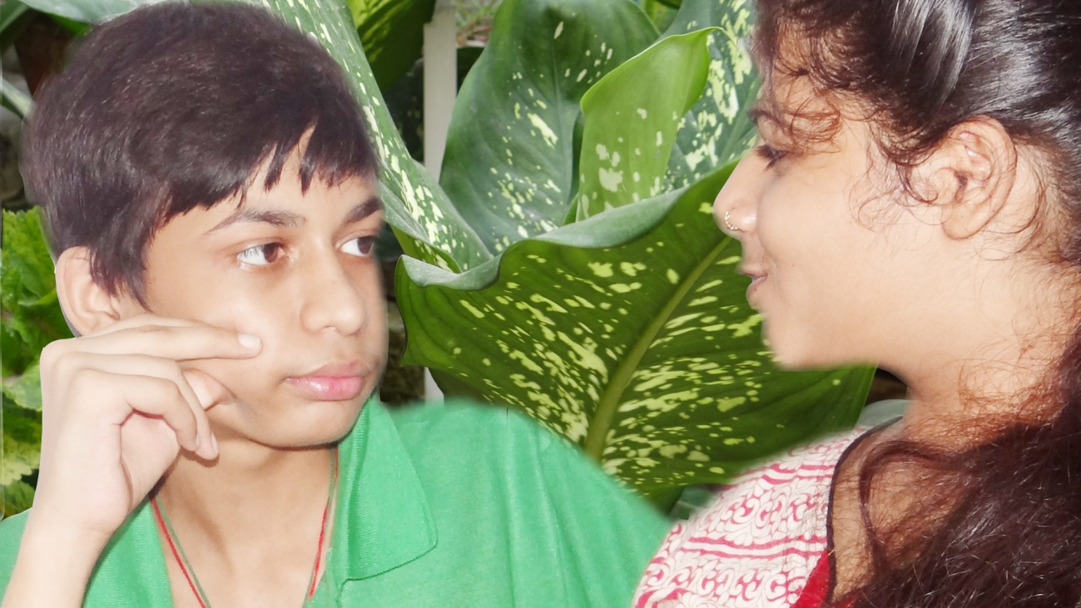
Attachment Theory
Definition of Attachment:
An enduring emotional tie to a special person, characterized by a tendency to seek and maintain closeness, especially during times of stress.

Slide 10
Four Categories of Basic Trust
Self Trust
Other Trust
Secure Attachment
High
High
Insecure
Anxious / Ambivalent
Low
High
Avoidant
High
Low
Disorganized
Low
Low

Slide 11
EMOTIONAL DEVELOPMENT
Attachment:
a close emotional relationship between two persons characterized by….
1. Mutual affection
2. Frequent interaction and close proximity
3. Selectivity

Slide 12
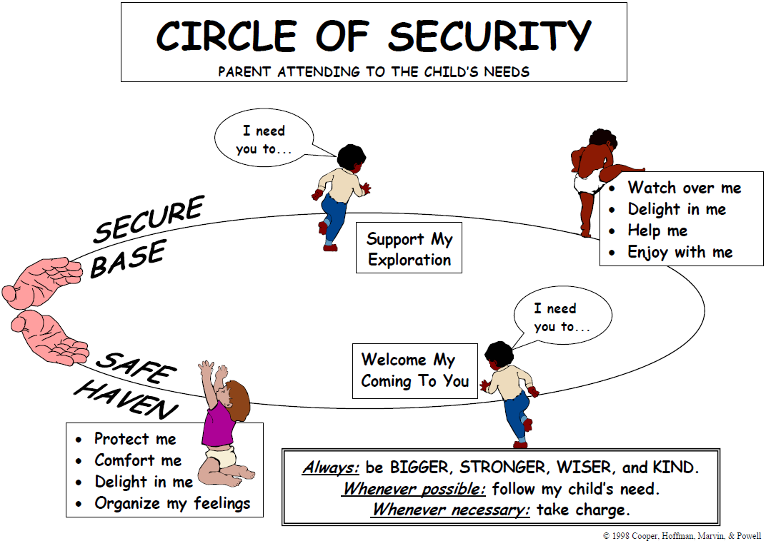
Attachment Theory – Characteristics
Attachment theory has its origins with John Bowl by.
Four key characteristics of attachment:
(1) proximity maintenance (wanting to be physically near to the persons we are closest to);
(2) safe haven (returning to attachment figure when feeling frightened or sense of threat (perceived or real));
(3) secure base (the attachment figure represents a secure base from which the child can explore their environment and other relationships;
(4) separation distress (anxiety when attachment figure is absent).

Slide 13
A journey of ideas: a resilience framework
‘Resilience is ordinary magic’
Overcoming the odds, coping and recovery
Ecological perspective – individual development and social context
Gives coherence to ideas discussed above:
Promoting resilience through:
Attachment. stability, continuity;
Positive sense of identity
Promotion of education, health and welfare
Social transition – gradual and extended;
Supporting pathways to adulthood
Across the life course - in care, leaving and after care, and;
Through universal and selective services

Slide 14
All Behavior has a Cause
CHANGE OF SCENE: hoping the behavior will not happen again
ATTENTION: get others to pay attention, even if that attention is negative.
AVOIDANCE: avoid doing a task
REWARD: receive rewards after a behavior

Slide 15
Even when a problem occurs
You Should:
REMAIN CALM: communicate before, during and after the behavior
RE-DIRECT: interaction to another activity
REWARD: Reward should begin immediately. Do not wait for the person to calm down
RE-GROUP : think about what happened before, during the after the situation. Discuss the situation with other staff.

Slide 16
Changes We Make
BE MORE AND LESS
Supportive Controlling
Accepting Contingent
Tolerating Judgmental
Co – participatory verbally Directive
Guiding/ Directive Questioning
“Let’s….” “Do You Want”
Flexible Rigid
Empowering Dominating
A Friend showing Staff in position
Mutual Respect of Authority

Slide 17
Understand ABC
ANTECEDENT
You write down what happened
Before you saw the behavior.
What was person doing?
Who were they with?
BEHAVIOR
You describe behavior
CONSEQUNCE
You describe what happens just after or as result of the behavior?

Slide 18
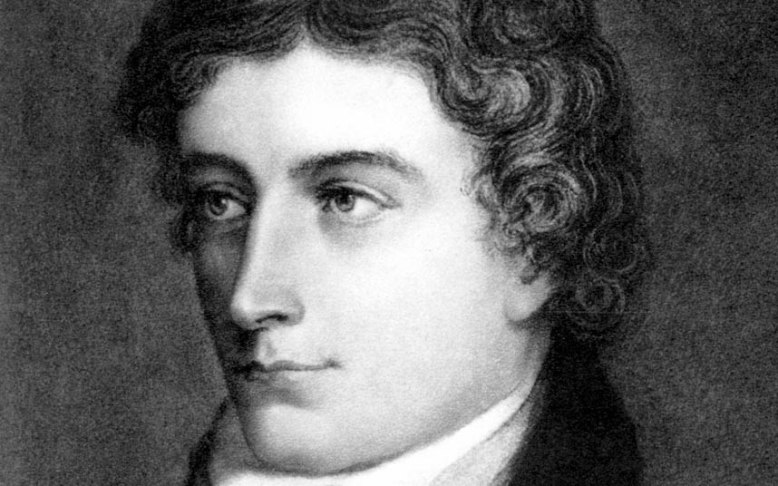
John Keats – 1795-1821 Second generation of Romantic poet
Life is
nothing short of
extraordinary!
He once coined in a short letter to his brothers,
“Negative Capability”

Slide 19
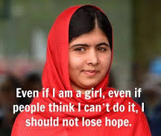
-ve
+ve
Negativity
Capability
together
The ability to remain capable
Ability to accomplish extraordinary things
should be Empty Space

Slide 20
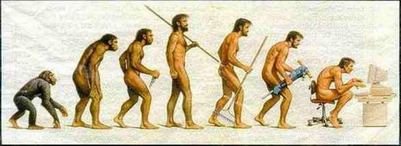
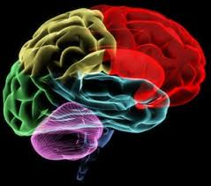
Paradigms and Assumption
Man’s search for meaning is the primary motivation in his life
When people see some things as beautiful, other things become ugly.
When people see some things as good, other things become bad.
Isn’t about opening our minds to bigger ways of thinking
but to the experience of not having any answers at all

Slide 21
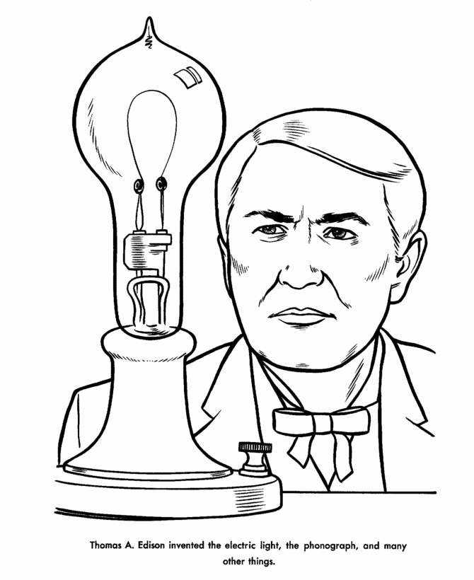
Thomas Edison
Thomas Edison, who tried 900 filaments before he found one that worked and finally invented the light bulb.
It was his ability, his Negative Capability, his “Never mind”, to keep an open mind, that enabled him to keep trying.
Failure was not only the key to his success, it was a way of being.

Slide 22
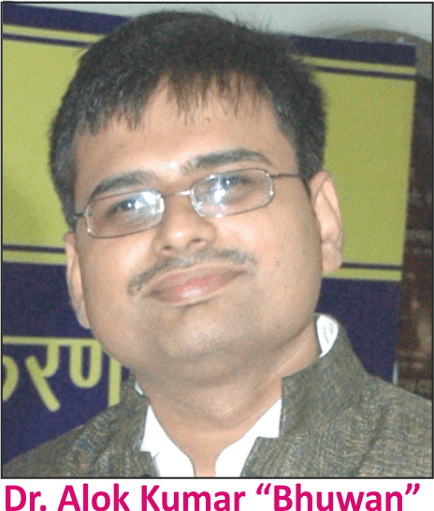
Thank You
Professional Qualifications of Resource Person:
• Doctor of Art in Special Education, USA
• Master of Science in Rehabilitation Science, USA
• M. Ed. in Special Education, OU
• B. Ed. in Special Education, MPBOU
• B.Sc. (Honors) Phy, BNMU
• Postgraduate Diploma in Distance Education, IGNOU
• Diploma in Vocational Training & Employment , NIMH
• Professional Practice Certificate in Autism Spectrum Disorders, USA
• SPELD-SA Teaching a Child to Read and Write (e3-Learning USA)
• Making Your Case – on how to communicate with Public Officials, Council on DD, USA
• Professional Certificate in Sexuality Education for Persons with Developmental Disabilities
• Diploma in Mass Communication & Journalism, IUMCJ
• Certificate in Office, Administration and Management

