Slide 1
Disability among Indian elderly: Issues and way forward
Ms. Aishwarya Raj
Clinical Psychologist Student Wellness Centre, AIIMS, New Delhi
Ms. Soni Jaiswal
Clinical Psychologist Student Wellness Centre, AIIMS, New Delhi

Slide 2
A country is known as a gray nation if it has 7% or more population aged above 60 years.
Currently more than 30 countries including most of the European countries and many developing countries like India and China are becoming gray countries.
Notes:
The number of elders in senior homes is expected to double by the year 2030, one-third of whom will have a disability or illness. It means that in the next twenty-five years, there will be about 72 million seniors in elderly care communities.
The united nations has considered a country as gray nation if it has 7% or more population aged above 60 years.
And now more than 30 countries including most of the European countries and many developing countries like India and China becoming gray countries.

Slide 3
Increased life expectancy and advancement in health care has helped us to win over debilitating medical conditions however….
The improvisations in medicines and technology have given longevity however….
This has lead to a positively skewed population graph with a variety of morbidities and disabilities associated with increasing age and other morbidities.
Notes:
Increased life expectancy with advancement in health care has helped us to win over debilitating medical conditions. However, this has also led to a disfigured population graph with ever increasing proportion of graying population.
The technology medicine has given longevity however along with increased dependencies and no one to take care of.

Slide 4
Aging adults face challenges related to physical health, disability resulting in issues such as decreased sense of self, capacity and wellbeing.
Some of the most common issues are :
compromised mobility,
sensory impairments,
empty nest syndrome,
retirement,
financial constraints or
death of spouse/ friend/s.
Notes:
This all gives a feeling of lack of satisfying health condition and human relationships causing loneliness

Slide 5
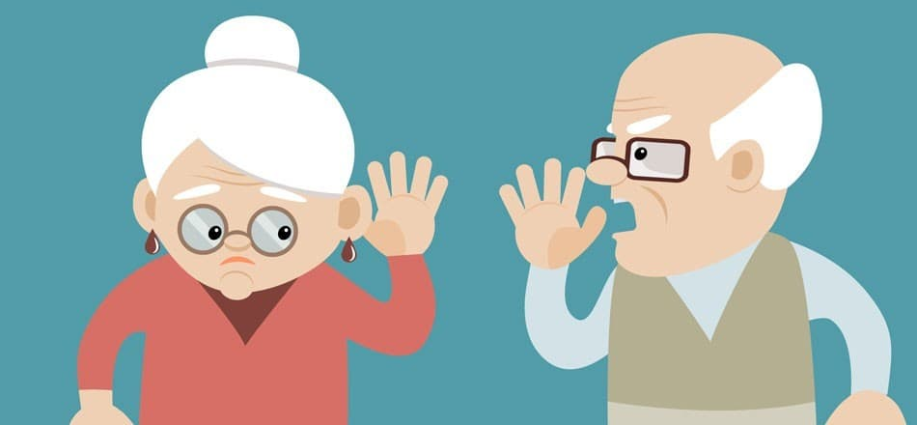
As people proceed towards growing old they experience a lot of age related deficits.

Slide 6
Economic Insecurity:
Notes:
The financial difficulties get compounded by the fact that aging reduces physical and mental capacities limiting their access to resources.

Slide 7
Economic Insecurity:
Elderly often feel the economically insecure due to lack the opportunity and capacity to be as productive as they used to be.
A survey stated that 76% respondents reported no financial assets in their name.
(Rajan, 2006)
Notes:
The financial difficulties get compounded by the fact that aging reduces physical and mental capacities limiting their access to resources.

Slide 8
Failing health:
Failing health due to advancing age is related to non-availability or inaccessibility of health care services especially in the developing countries.
Lack of awareness and knowledge and high cost of disease management making caring for ailing health a burden to the person as well as the caregiver. This picture worsens for the elderlies from lower socio economic status.
The elderly perceive their health as inadequate.
“STATE OF ELDERLY IN INDI,” n.d.
Notes:
It is commonly said that we start dying soon after we are born. This statement is synonymous with failing health.
Failing health due to advancing age happens because of a lot of reasons such as non-availability or inaccessibility of health care services especially in the developing countries or lack of awareness and knowledge and high cost of disease management making caring for ailing health a burden to the person as well as the caregiver, this picture worsens for the elderlies from lower socio economic status.
According to“STATE OF ELDERLY IN INDI,” n.d.) the elderly perceive their health as inadequate.

Slide 9
In a national level survey almost 55% elderly were finding their health unsatisfactory.
This figure is quite large compared to those 17% reported by WHO
for general population.
(Pilania, Bairwa, Kumar, Khanna, & Kurana, 2013)

Slide 10
Health causes
Poor health conditions have been defined as the prevalent cause of elderly loneliness. Both physical and mental health have been found to play role.
Physical health in elderly deteriorates at a fast pace leading to poor functional status and sometimes functional disability. Also decline in functioning of sense organs leading to impaired vison and hearing loss, lack of outdoor activities, inability to carry out activities of daily living, needing help in these activities, inability to go to post office/bank.

Slide 11
Mental health difficulties such as Incapacity of cognitive resources,
Fluctuating mood,
Anxiety have been found to impact elderlies the most.
Depression has been found to be the leading cause of loneliness amongst elderlies. It is often seen that loneliness is the cause of depression or vice versa. However, the treatment often ignores loneliness as a cause rather it is treated as a symptom that may subside with treatment.

Slide 12
Mental health difficulties
Loneliness is linked with depression but not all depressed elderlies are lonely and not all lonely elderlies are depressed.
A decrease in mood, increases the risk of loneliness. Unfulfilled expectations from contacts can affect the psychological well-being of the elderly.
Leiderman, P. (1969). Loneliness: A Psychodynamic Interpretation. International Psychiatry Clinics, 6, 155-174.

Slide 13
Reduced social activities
Deteriorating health,
injury and
functional immobility
can affect elderly participation in social activities such as reduction in social activities or lack of social activities leading to loneliness often known as social loneliness.

Slide 14
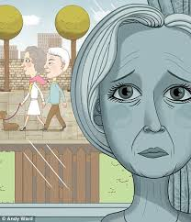
Living alone
Staying alone has been found to be the most consistent risk factor for loneliness among various studies on elderly.
As per the data more than 50% of 75years old women live alone and one third of men aged 80 live alone. However, it has to be noted that elderly people may live alone but still have a web of relationship.
Cattan et al 2015
Notes:
In tradition eastern families the elderlies played a significant role in family decision making and were highly respected. It was often considered sinful if the elderly person is left alone.

Slide 15
Neglect & Abuse:
In India, elderly are respected and taken care of however in the recent years the social transformation has led to disintegration of the family system and has resulted in the isolation of the elderly.
(Rajan 2004)
The recent times have seen increased episodes of deprivation, material exploitation, humiliation, abandonment and harm to physical and mental health of elderly.
(Shankar Dass, 2009)
Notes:
Because of isolation they may also become victim of criminal activities.

Slide 16
Neglect & Abuse:
Elderly having failing health, dependency, need of support and care. Most of the care givers perceive it to be natural for their age and therefore consider it normal leading to neglect and abuse.
Demanding jobs, nuclear families, changing lifestyles are often the prime reasons for neglect of elderly.
(Gupta, Mohan, Tiwari, Singh, & Singh, 2014)
Notes:
Because of isolation they may also become victim of criminal activities.

Slide 17
Disability in old age should be a focus of all public health policy and programs and cover the whole continuum of services aimed at both preventing disability and restoring functional capacity through rehabilitative measures.

Slide 18
How to bridge the gap?
Purpose of bridging is to
improve efficiency,
equity of care,
inclusion and
support at all levels.
Notes:
Bridging encompasses a range of concepts, tasks, technologies and practices aimed at improving knowledge sharing and collaboration across stakeholders, organizations and fields in care and support for persons with disabilities, their families, and the aging population.
Bridging task include activities of dissemination, coordination, assessment, empowerment, service delivery, management, financing and policy.

Slide 19
Development of a positive culture of ageing would need to be based upon:
prevention of the development of disability and
forestalling the formation of a disabling environment such as :
including the improvement of housing conditions and
neighbourhood quality in order to…
Notes:
facilitate the engagement of older adults in social and
physical activities

Slide 20
Long Term Care and Universal Health Care
Even though the proportion of older persons in the total population is 8.9 per cent, this translates into more than 100 million older persons out of which more than 12 million are age 80+.
Many older persons are in need of structured support for long-term care, a perceived burden borne mainly by families who are the primary care givers.

Slide 21
Long Term Care and Universal Health Care
India is moving towards the goal of universal health coverage,
a goal of national policies and the 2030 Agenda for Sustainable Development,
there is an opportunity to integrate long-term care within it from the outset – Proactive approach
Ministry of Health and Family Welfare (MoHFW) (2011). National Programme for Health Care of the Elderly: Operational guidelines. New Delhi: Government of India. Available from http://mohfw.nic.in/showfile. php?lid=1403.

Slide 22
Manpower Of Professionals
Long-term care need will tend to grow with the ageing of the population hence the care economy will also grow.
Requiring more workers with specific human resource skills such as geriatricians, stronger geriatric components in medical and nursing curricula, rehabilitation experts, psychologists, social workers, care workers and care coordinators.
Integrating these with the primary caregiver experiences.

Slide 23
Intergenerational Solidarity
Western countries have acknowledged the important role of intergenerational solidarity in providing long-term care and support for older persons.
Volunteers from youth clubs as well as “younger” older persons are often engaged in providing volunteer care services at home for older persons.
Intergenerational support can prove to be an important variable in Community-based long-term care system.

Slide 24
Some of these countries have addressed long-term care within universal health care systems, whether tax-funded or through social insurance.
This could be replicated in India to the extent possible and allowed by resources.
Such as incentivizing the families that care for the elderly at home by providing tax incentives, rebates or by helping in partial financing of healthcare/ nursing services.

Slide 25
National Policy for Geriatric health
A need of national policy for the geriatric health having special provisions for mental health.
Geriatric centers with trained professionals should be opened so as to cater to the elder population which mainly resides in the villages and cannot seek services.

Slide 26
Awareness and Sensitization
It becomes important that familial support continues to be present with the elderly.
Programmes need to be developed that promote family values and sensitize the upcoming generation on the necessity and importance if intergenerational bonding.
State policies can be formulated to encourage children to co-reside with their parents such as preference in allotment of houses.
Notes:
Social security has also been a major issue to be addressed. As family is the most cherished social institution, it also serves as the most vital social security system.

Slide 27
REVIEW
Despite several efforts and policies
the elderly still lack
Security – financial, emotional and social leading to increasing incidents of deprivation, abandonment and at disposal of criminal activities.
There is a need of a strong social security system in our country to address the changing demographics and shortcomings of the existent schemes proposed for the benefit of elderly.

Slide 28
CONCLUSION
In rapidly changing Indian society, the family support system for old age care is under strain.
Many older persons do not have any support system and live alone. In such a situation, support from civil society organizations and the community may be the only resource for these older persons.

Slide 29
CONCLUSION
Interventions should be aimed at increasing the possibilities for older people to maintain their functional capacity and regain it after succumbing to a disease.
Interventions particularly in the areas of
health promotion,
disease prevention,
treatment and
rehabilitation.
Notes:
take the form of socio-cultural activities as well as health and care management in the
community and in hospitals.

Slide 30
THANK YOU

