Slide 1
Saath-Saath (Quality of Life Center)
Safe and joyful living within the community
Care and Joyful Days for People with High Support Needs
By Ms.Sonam
Center Incharge Saath-Saath

Slide 2
Why Saath-Saath
For the community, by the community with the community.
Safe and secure environment.
This Program enhances communication skills, personal hygiene and grooming skills etc.
Students make their own choice to be independent in the community.

Slide 3
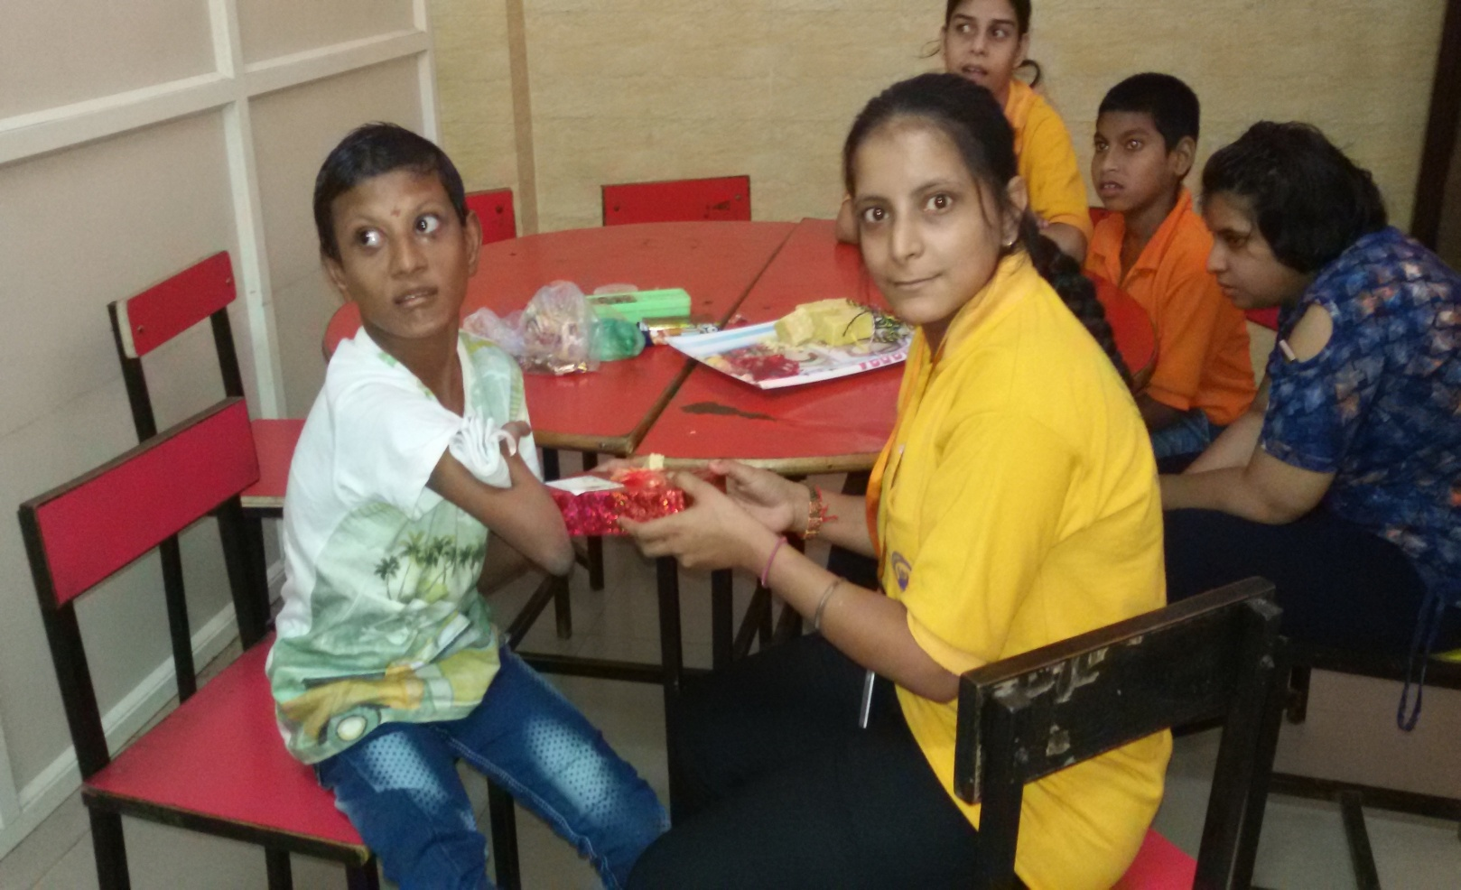
Stone to Apple
Charanjeet Kaur wants to join the sports and cultural activites
She is Interested to live in Independent living center
After trainging she makes hairstyles for her self and others.
Now she brings apple for all not the stone.

Slide 4
Learnerd Privecy
Neha maintains her hygiene, grooms properly, closes the door while using washroom.
She smiles and shows joyful gestures to all instead of fighting with all.
She memorise and concentrates on learning yoga, poems etc.

Slide 5
Change the perspective of Parents
Change the thinking towards their own children
Regular send them for school and outing
Developed the positive attitude
Start sending their girl child to school
They are happy

Slide 6
Our journey
Students start caring for their other peers and family members.
Enjoy music ,Dance.
Make their own choice regarding dress,food,choice of movie and outing etc.
We feel safe at our centre Saath-saath

