Slide 1
My Legal Capacity
By
Mr. Inder Mohan Sharma

Slide 2
The appropriate Government shall ensure that the persons with disabilities have right, equally with others, to own or inherit property, movable or immovable, control their financial affairs and have access to bank loans, mortgages and other forms of financial credit.
Persons with Disability has equal basis with others in all aspects of life and have the right to equal recognition everywhere as any other person before the law.
From
Rights of Persons with Disability Act, 2016

Slide 3
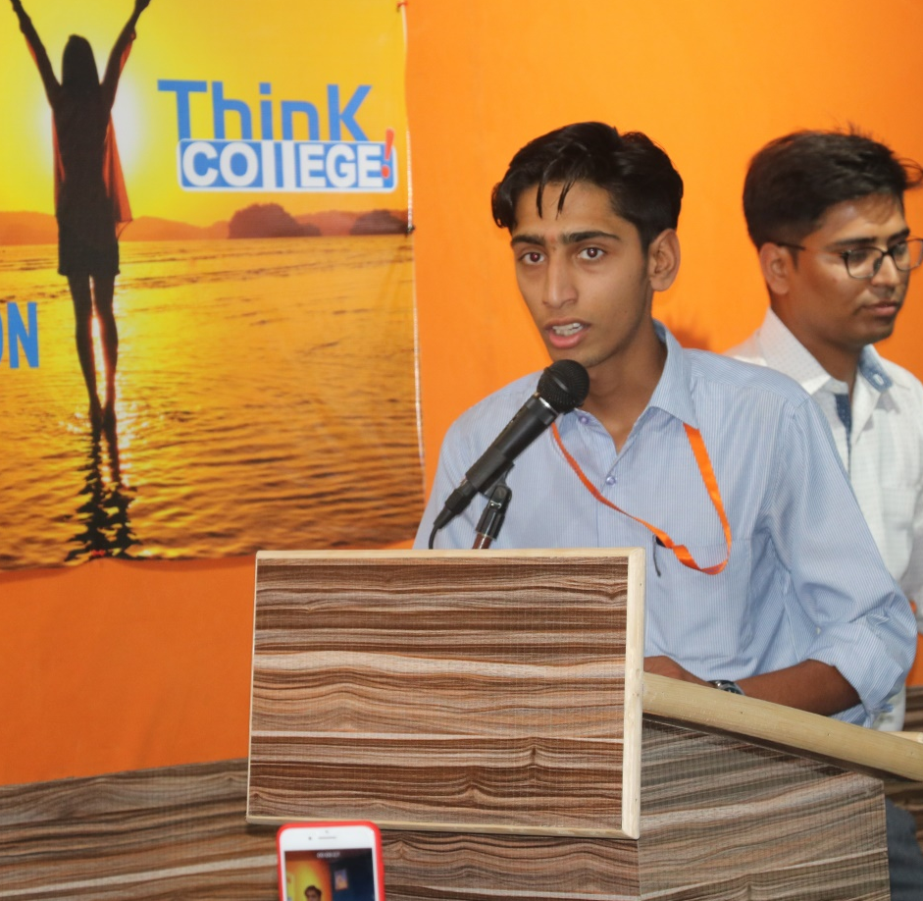
About Me….
I am Inder Mohan Sharma.
I am 22years old.
I complete Secondary in 2016.
I am pursuing my training in Domestic Data Entry Operator course under Information Technology from Manovikas Institutes for Higher Education.

Slide 4
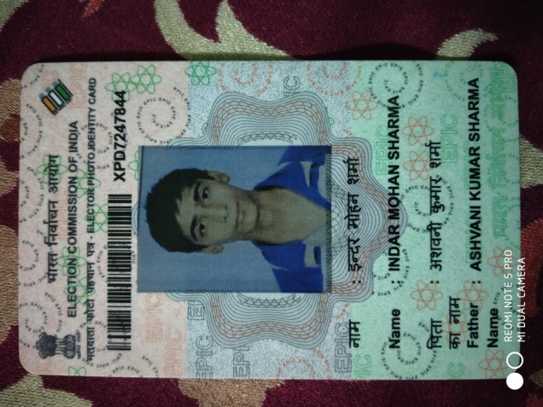
In the past, people with disabilities have not been treated as equals. But India has ratified with the Rights of Persons with Disabilities Act, 2016 which says that people with disabilities have the same rights as everyone else and are equal before the law.
But, I Inder Mohan Sharma, Citizen of India give my valuable vote.

Slide 5
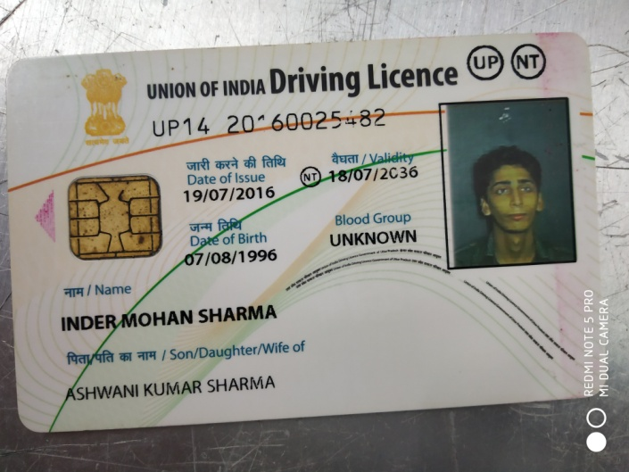
I live my life as other live
I use my smart phone.
I live my social life on Facebook, Whatsapp, Snap chat and Twitter.
I drive vehicles: four wheelers and two wheelers.
I also have driving license.

Slide 6
Thank You

